Slide 1



BUILDING SUCCESS FROM INNOVATION
SHAPING SPACE & DEFENSE FOR 35 YEARS:
YOUR CHALLENGES DRIVE OUR SOLUTIONS

Slide 2






Software Company
SMART SOLUTIONS FOR THE SATELLITE INDUSTRY
35
Years of
Experience
35%
R&D Investment
100
Integrasys
Employees
9
Innovation
Awards
Smart Solutions for Satellite Network Automation
Leading Customers within the Defense
& Satellite Industry
R&D Projects

Slide 3










Our Awards

Slide 4
Our Story
1990
1992
1995
2000
2005
2007
2010
2011
2012
Telefonica
Government
Programs
Hispasat
European FP
Projects &
Government
STM
First US Patent
3 Europe Patents
ESA
iDirect
ME
Detecon
ITC KSA
LATAM
SkyNet
Telespazio
ViaDireta
2023
2020
2019
2018
2017
2016
2015
2014
2013
PSN
Artel
Ukraine MoD
NI USG
US Patents
Growth Globally
Orange
Intelsat
L3Harris
Mercury
US MoD Army
GATR Cubic
DRS
Kymeta
ME Support
UHP Networks
SpaceBridge
JSAT
MEASAT
Hellas Sat
STC
Asia Office
Comtech
Fiji
Spark NZ
Carnival
Thaicom
Nelco
Global Networks
Marlink
Speedcast
US Office
Australasia
Optus
Alaska GCI
InfoSAT
Telesat
Hughes
LATAM
Pegaso
Entel
LBiSat
Asia
Singapore MoD
Growth in Americas
AT&T
RigNet

Slide 5














Organization
C-BOARD
R&D | SALES | SUPPORT
HEADQUARTERS
SALES | SUPPORT
INTEGRASYS SARL
MADRID OFFICE
INTEGRASYS LLC
Luxembourg, LUX
VA, GA y FL, USA
Excellence Center
INTEGRASYS UK
Kiev, UKR
London, GBR
Excellence Center
Toulouse, FRA
INTEGRASYS PTY LTD
Sydney, AUS
INTEGRASYS Asia
Yakarta, IDN
R&D Office
INTEGRASYS UAE
Seville, ESP
EMEA SALES OFFICE
Dubai, UAE

Slide 6



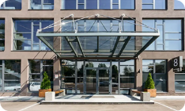
















Our Offices
HQ & EMEA Sales Office
MADRID, SPAIN
Regional Office Americas
WASHINGTON, USA
INTEGRASYS SARL
LUXEMBOURG, LUXEMBOURG
Excellence Center
KIEV, UKRAINE
INTEGRASYS UK
LONDON, UK
Regional Office
FLORIDA, USA
Regional Office
GEORGIA, USA
INTEGRASYS PTY LTD
SYDNEY, AUSTRALIA
Support Office
DUBAI, UAE
Regional Office APAC
JAKARTA, INDONESIA
R&D Office
SEVILLE, SPAIN
Excellence Center
TOULOUSE, FRANCE

Slide 7

Customers

Slide 8



Addressable Market
LEADING SMART SOLUTIONS FOR THE SATELLITE INDUSTRY
Defense &
Government
Broadcast &
Media
Oil & Gas
Aero
Broadband &
Enterprise
Maritime
Space Situational &
Domain Awareness
Earth Observation

Slide 9


























Our Partners

Slide 10
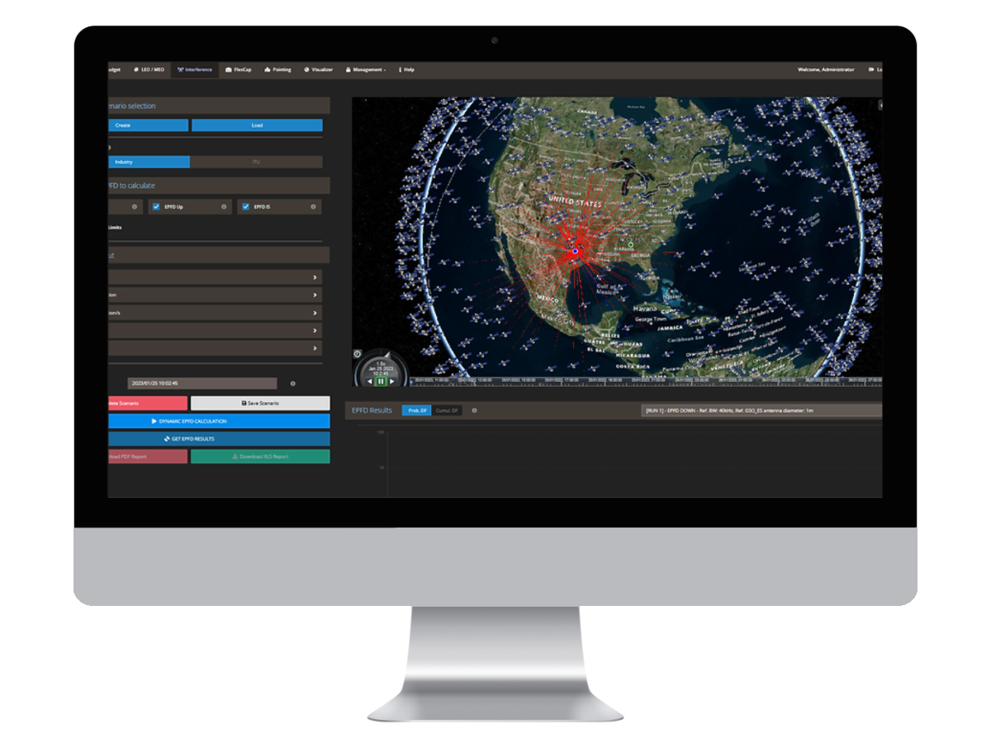
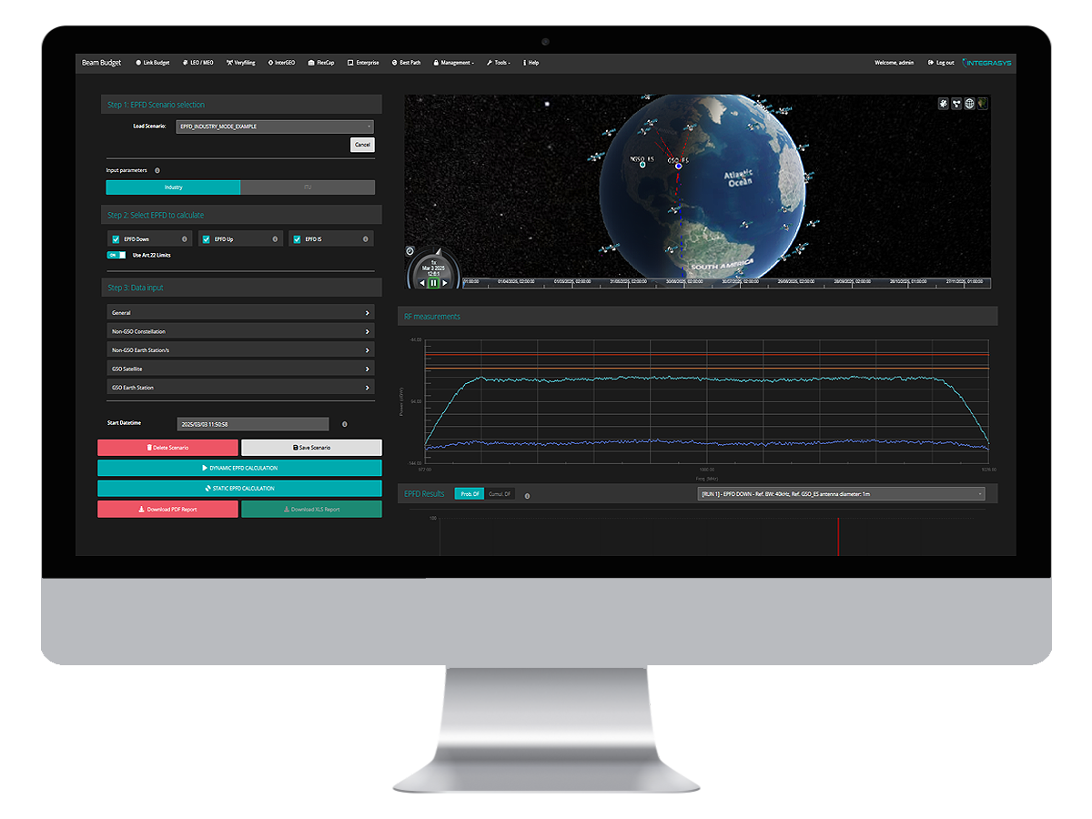
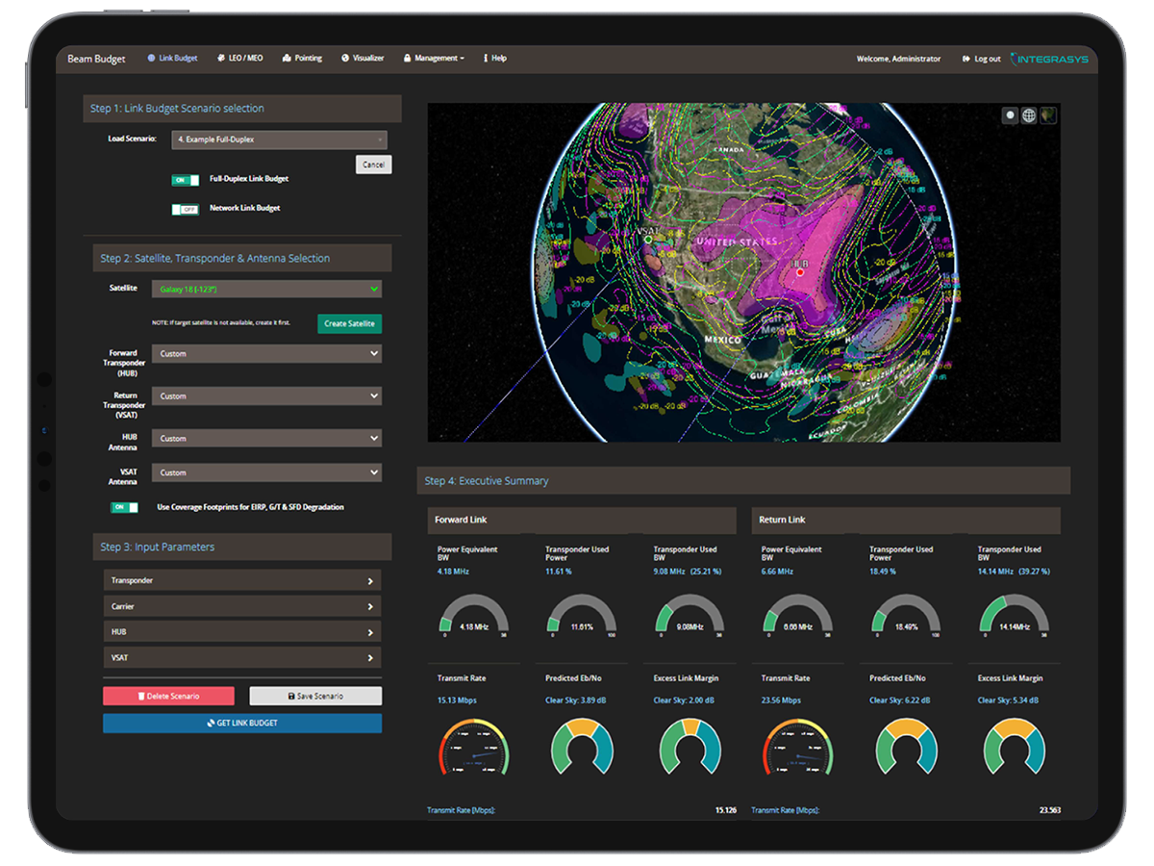
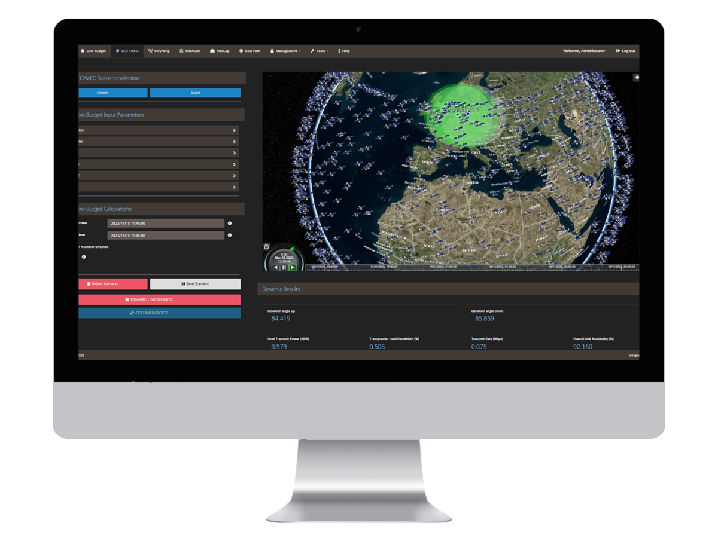
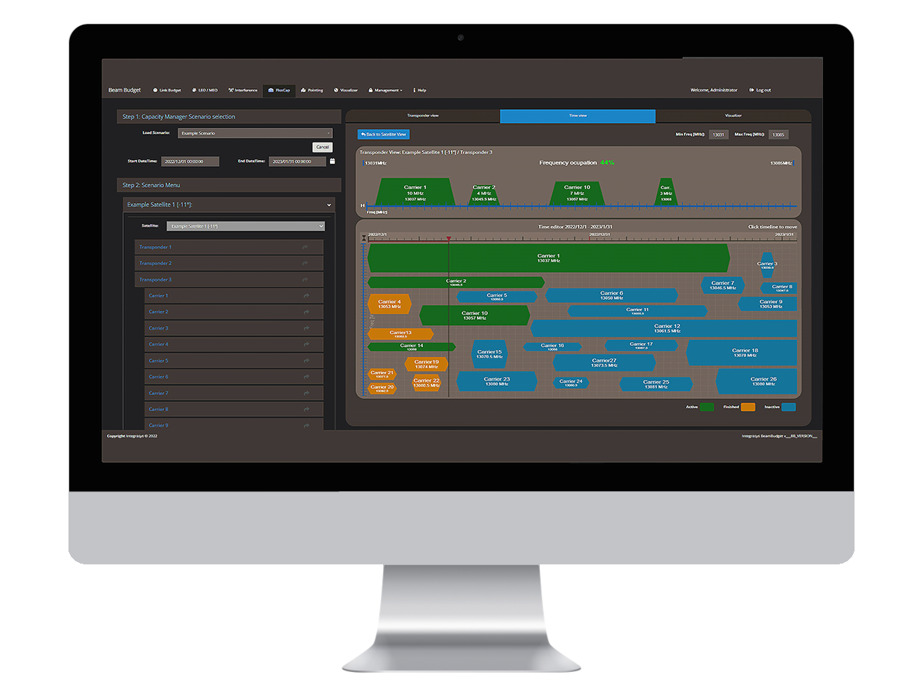
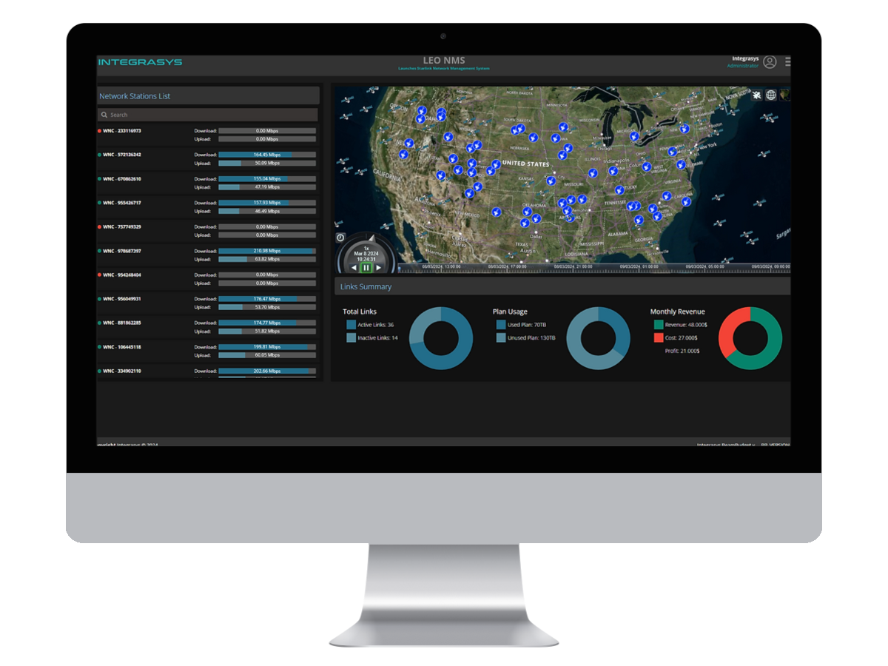
Multi-Orbit, Multi-Vendor
Network Automation (I)
REGULATING & EPFD CALCULATIONS
NETWORK DESIGN &
CAPACITY MANAGEMENT
TOOL VeryFiling | TOOL LEOREG
User-friendly EPFD calculation software aligned with ITU/FCC standards, for Satellite Operators and Regulators. | Web-based system empowering regulators to monitor and ensure NGSO constellation compliance with ITU.
TOOL Beam Budget | ADD-ON BestPath
Design a multi-orbit network that complies with each user requirements, mission requirements and available resources. | Identifies the best connectivity path, and backups with the customers’ antenna kits or satellites.
TOOL FlexCap | TOOL LEO NMS
Dynamically manages the multi-orbit pool of capacity (Mbits/MHz) by orchestrating users, contracts, bookings payments and invoices. | Manage, monitor, qualify , and report multi-orbit and multi-vendor network in a single screen.

Slide 11
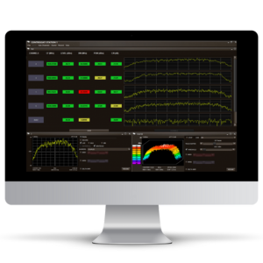
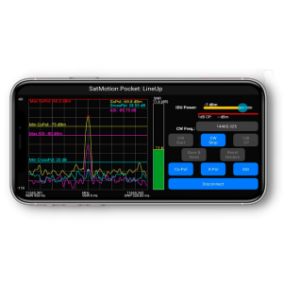
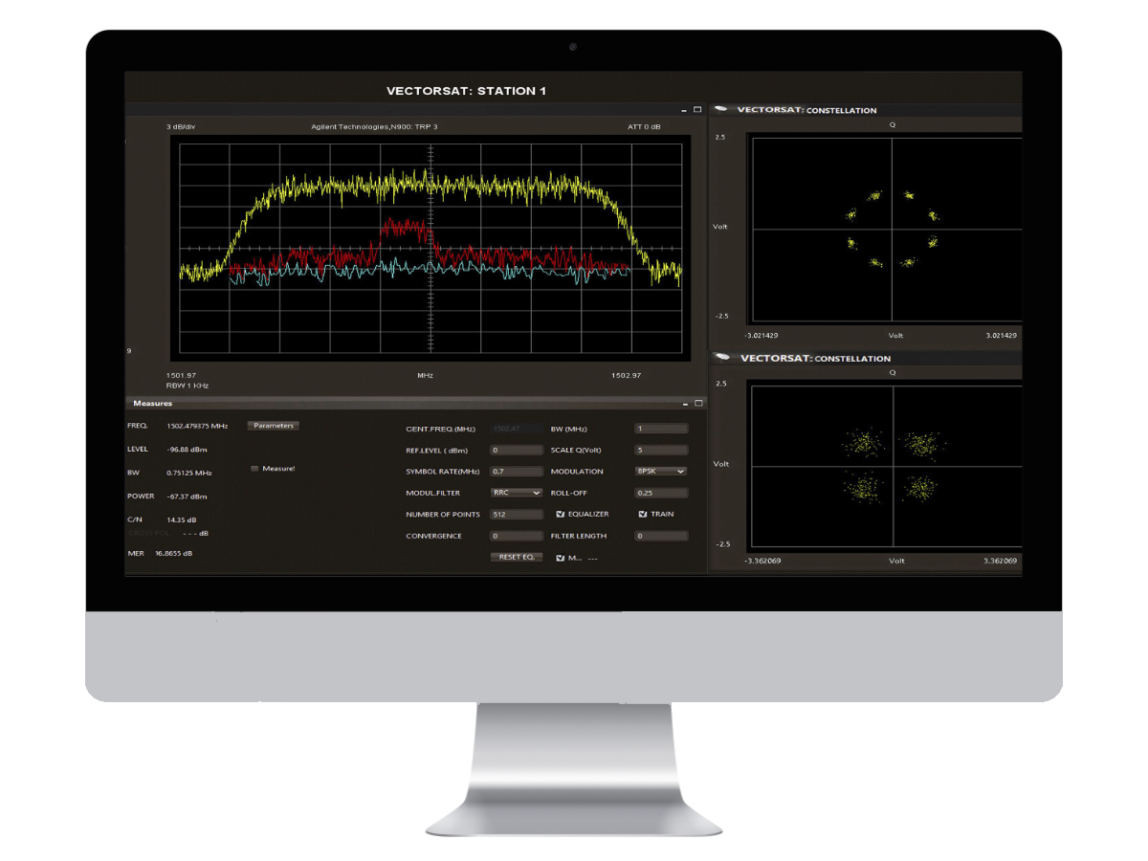
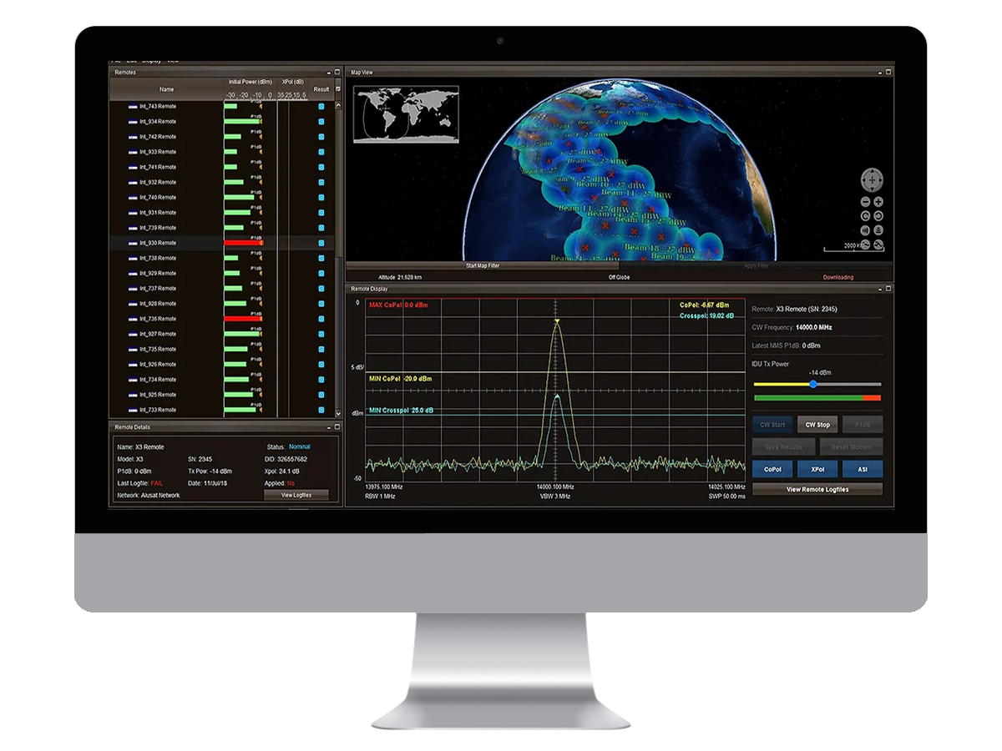
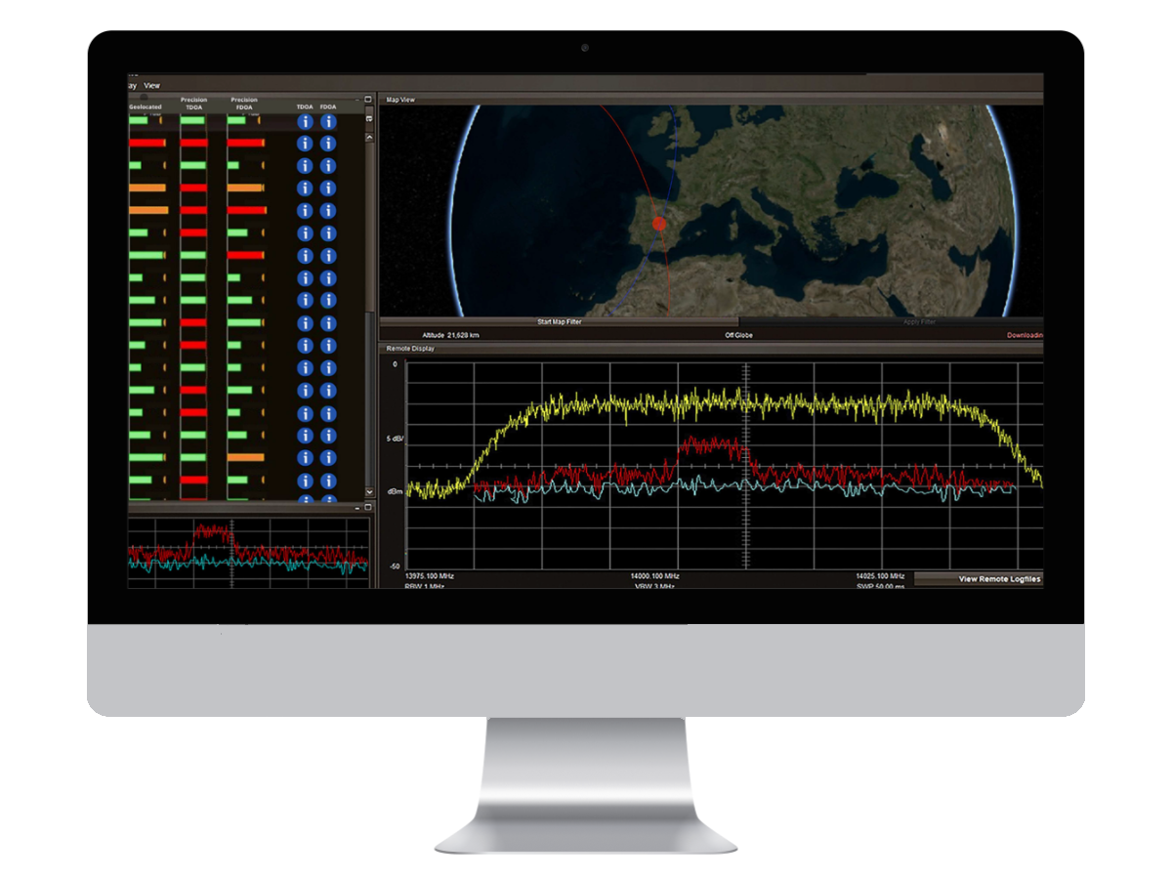
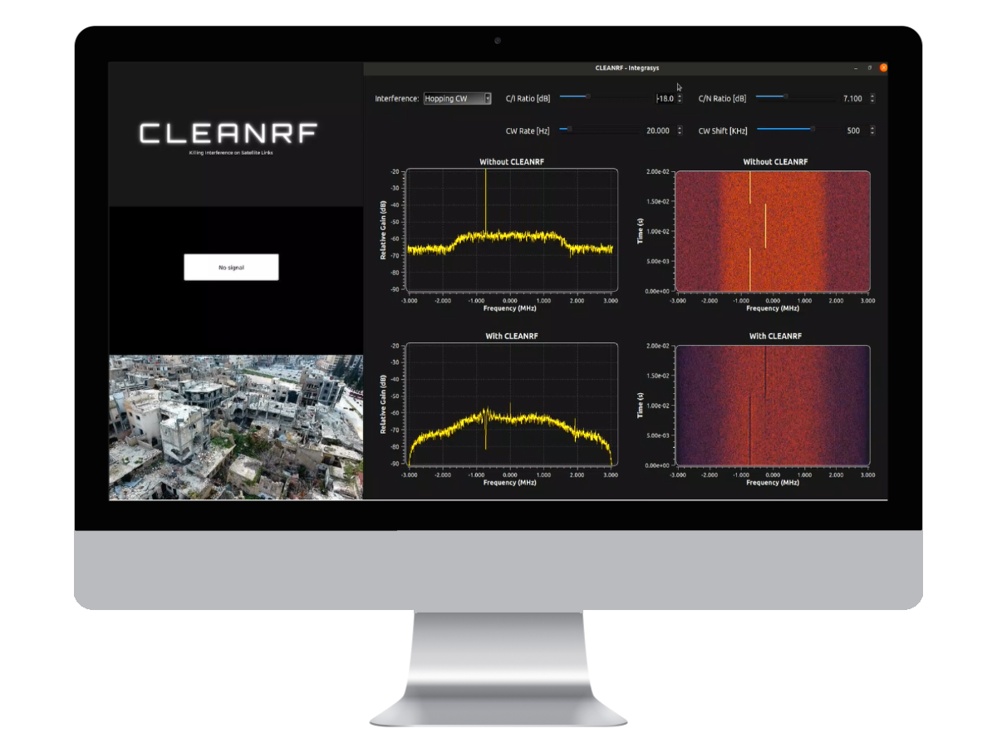
Multi-Orbit, Multi-Vendor
Network Automation (II)
MONITORING & DETECTION
DEPLOYMENT & MAINTENANCE
INTERFERENCE MANAGEMENT
TOOL Controlsat | ADD-ON Vectorsat | TOOL VirSat
Spectrum monitoring, signal degradation, and reporting availability, time to resolution and anomalies. | Signal characterization, Carrier under Carrier detection, modulation monitoring, MER, FEC. | Virtualized ground system that tests virtualized modems and hubs, digital BUCs, HPAs, and LNBs.
TOOL Satmotion | ADD-ON Alusat
Helps the installation team to install a link, certifying communication with NOC. | Allows unattended maintenance of the links with the different VSATs on the network.
TOOL InterGeo | TOOL CleanRF
Geolocate signals of interest and interferences for government requirements. | Eliminates multi-domain interferences by signal excision in real time on the Receiver Chain.

Slide 12
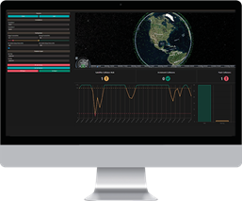
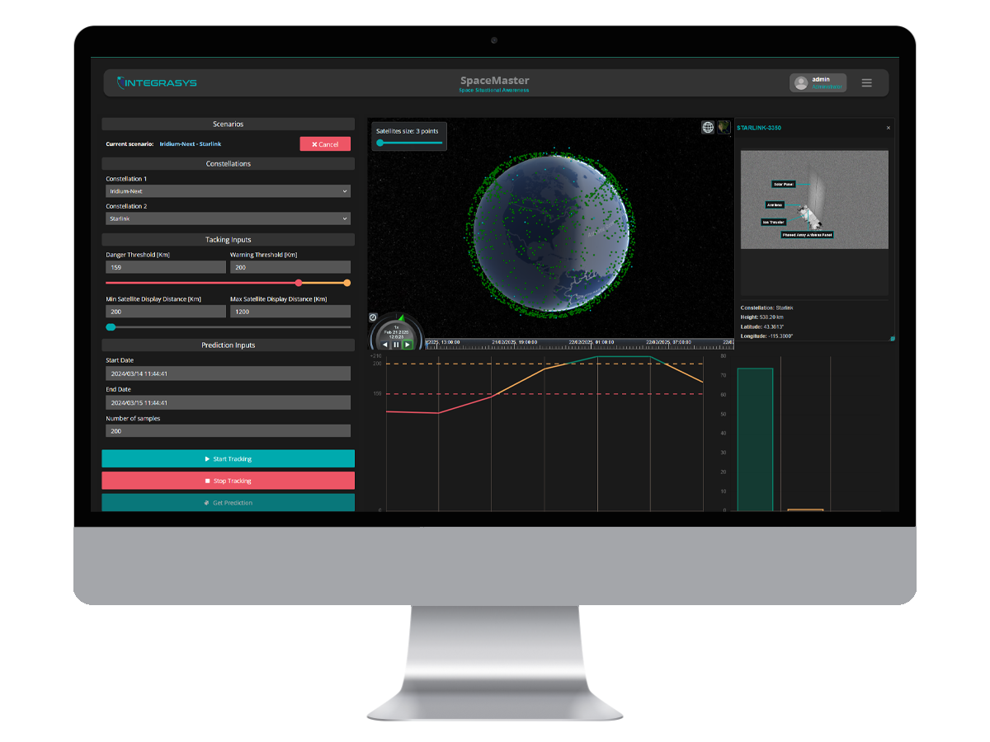
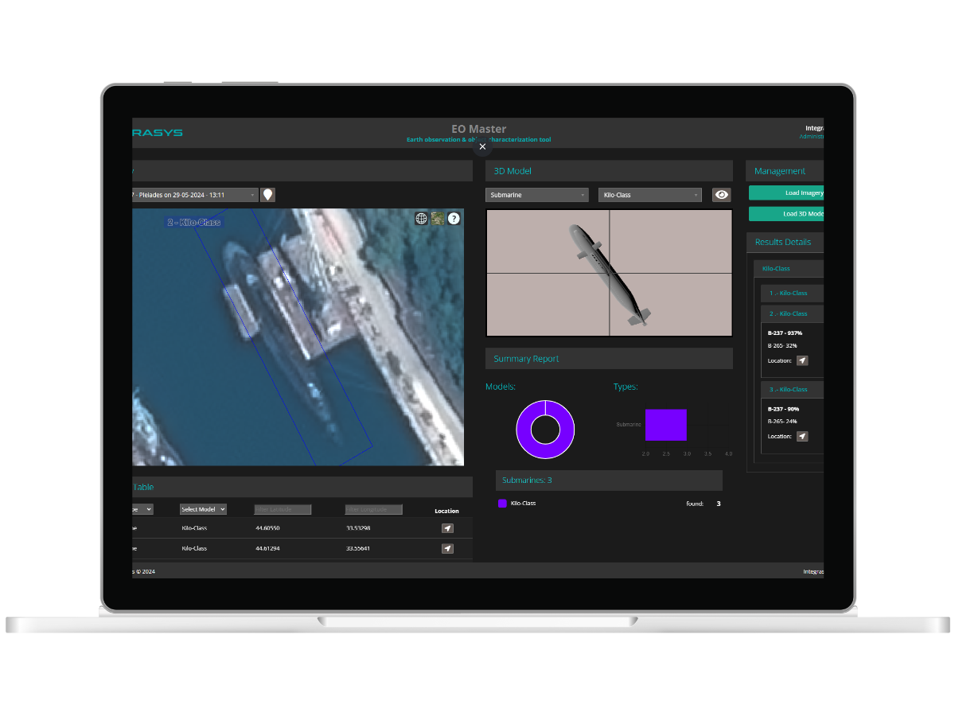
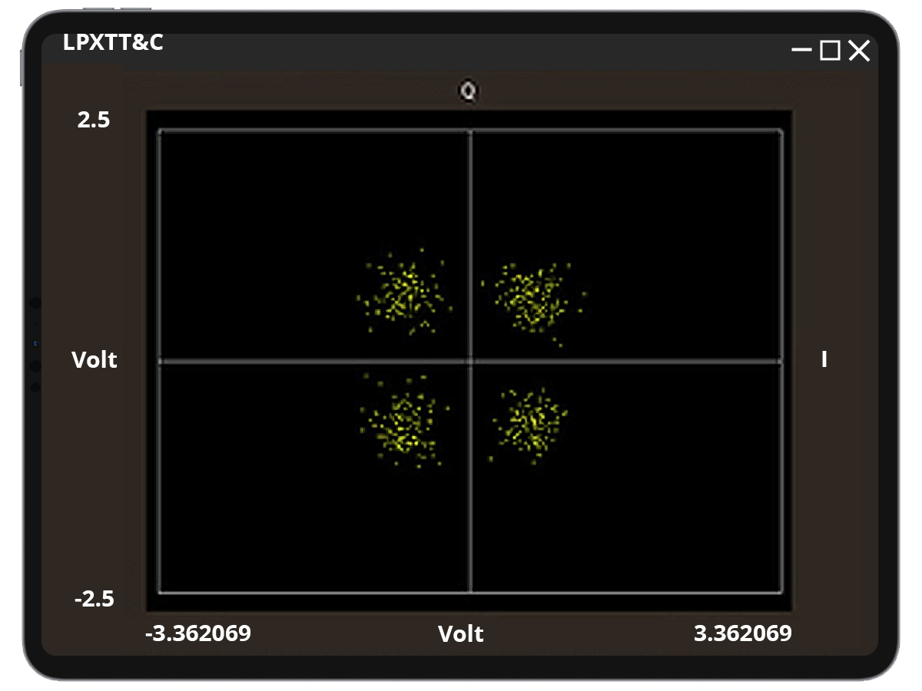
Defense
SPACE DOMAIN AWARENESS
ONBOARD & VIRTUALIZE MODEM
GEOINT
CHARACTERIZATION
TOOL Orbisat | TOOL Space Master
A cutting-edge tool for SDA that seamlessly integrates systems to detect and track objects in space. It prevents collisions between space debris and other space objects, while also monitoring for nearby satellite surveillance. | Ultimate on-premises AI and ML image processing solution, allowing for space tracking and monitoring in a congested and contested spatial domain. AI-powered automated reports.
TOOL EO Master
Characterizes military objects in milliseconds. System based on AI/ML over SAR and optical EO images.
LPXTT&C
1- Telecommand Telemetry and Control virtualized modem for multi-orbit intelligence or comms payloads with LPOD. 2- On board secure modem for satellite TT&C complex mission and operations with LPOD.

Slide 13

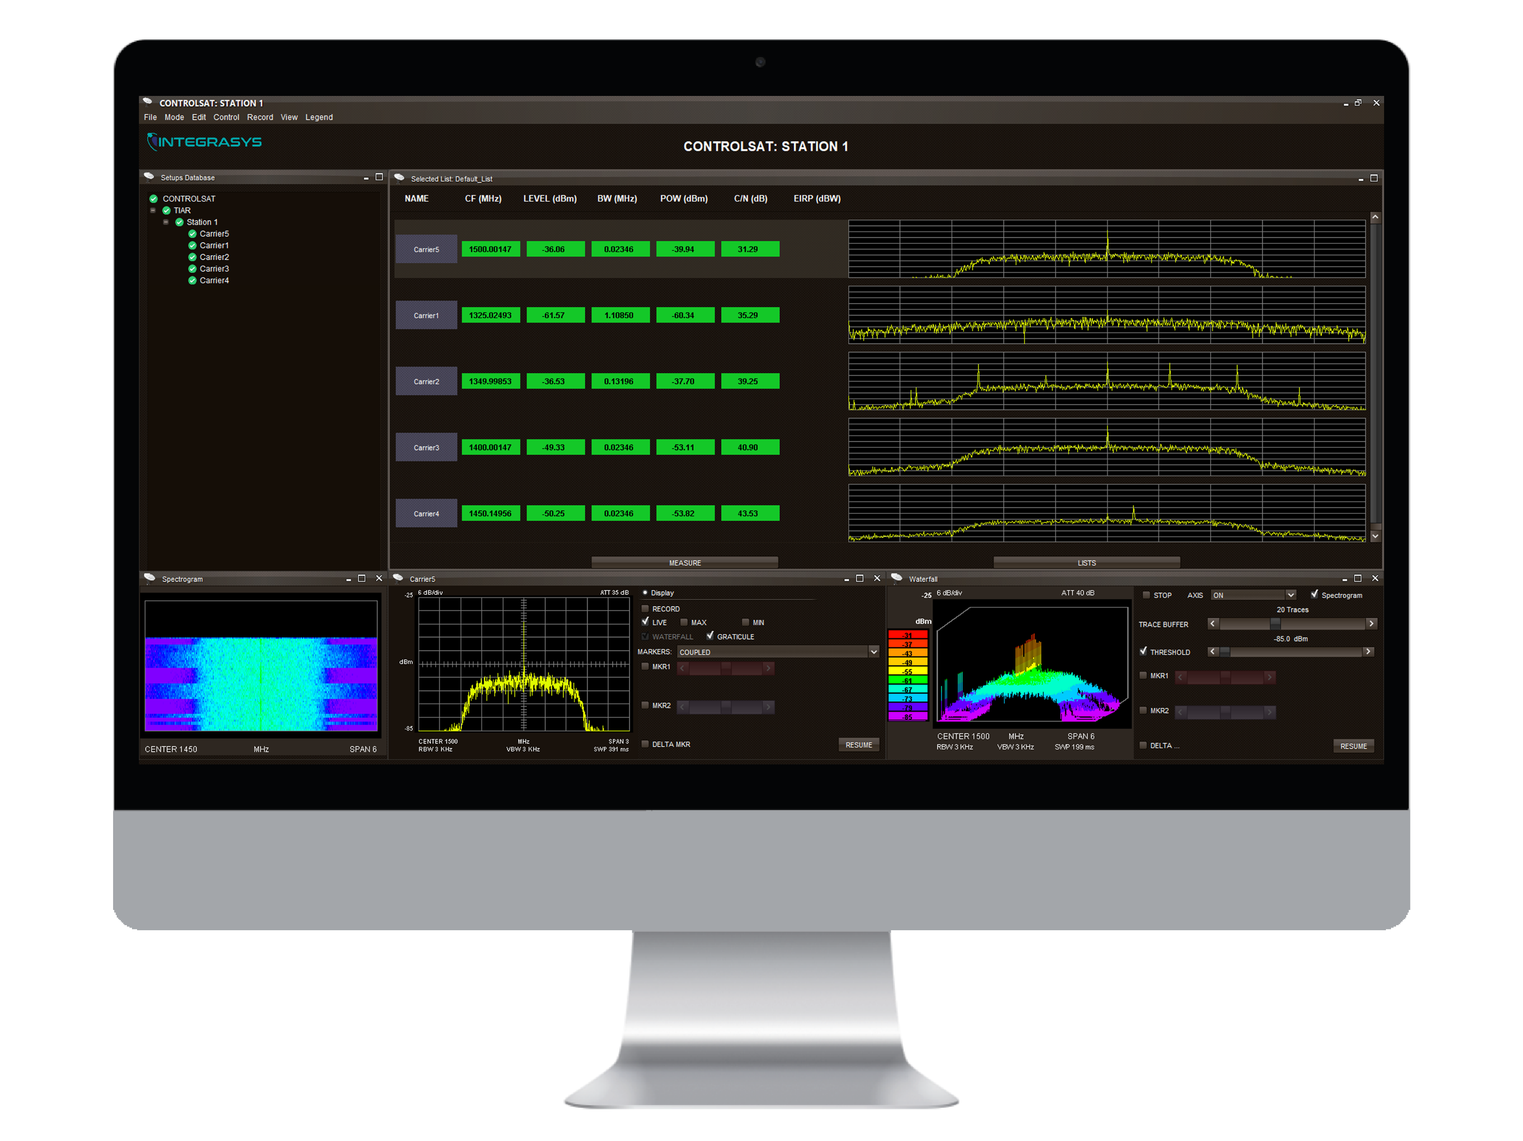
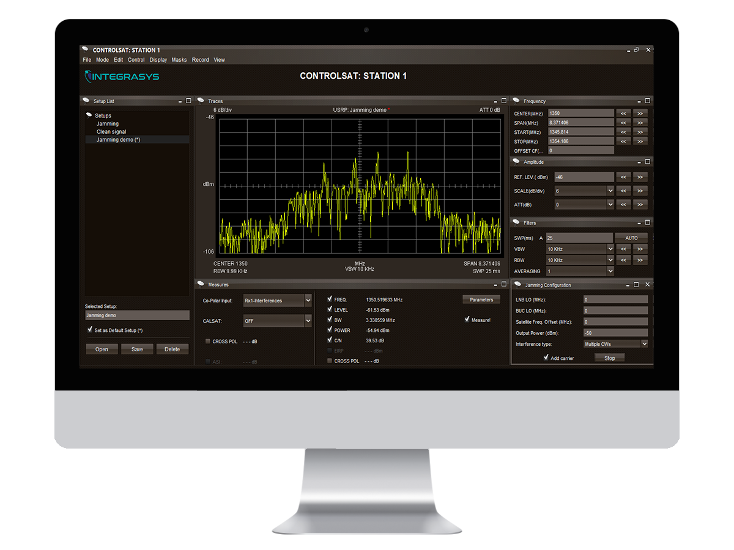
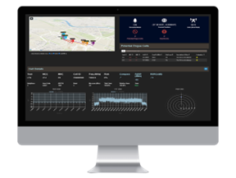
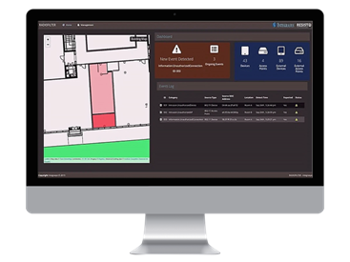
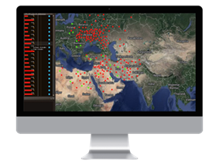
Network Cybersecurity
LAYER1 ENCRYPTION
JAM CCS
APNT
GSM 3G, 4G, 5G PROTECTION
WIFI MONITORING
FIRMWARE PROTECTION
TOOL CRYPTO CLEAN
Layer1 encryption for protecting critical communications against unknown sources’ reception or characterization of our signals, by combining jamming and anti-jamming capabilities.
TOOL Jam CCS
The smartest Counter Communication System for testing, jamming, or denying, and RF threats, simplifying and automating RF interference for ground, air, and space EW.
GNSS Antijamming
1- Anti-jamming and anti-spoofing capabilities develop to coexist with GPS Deny environments. 2- Spoofing and Jamming GNSS positioning and Navigation ground, sea, air and space.
TOOL RANMONITOR
Security events detection and monitoring for cellular networks. Remote detection and automated 24/7 monitoring of security in cellular towers.
TOOL RadioFilter
Automatic standalone system for WiFi events detection. Events are detected by secure IoT sensor nodes.
TOOL FWSEC
FWSEC solution is used for the firmware protection of connected sensors operating in Critical Infrastructures.

Slide 14










CAPEX or SaaS
CAPEX LICENSES
SAAS LICENSES
 | Cost Per Licenses
 | Scalability
Own Server + Hardware | Storage
 | Flexibility
 | Ubiquity
 | Restful API

Slide 15


Tailor-made Projects
Detecting our Customer Needs
Ad-hoc Training
Totally personalized meetings and constant follow-up
On boarding process and support subjected to our customer
Aligned with Guidelines
Integration 360
Totally adapted to the way
our customer works
We integrate with any device, hardware or logistics used by the customer

Slide 16

WEBSITE
www.integrasys-space.com
EMAIL
info.sales@integrasys-sa.com
EUROPE
HQ - +34 916 316 846
Seville - +34 955 638 650
Luxembourg - +352 278 746 056
Ukraine - +380 44 391 8288
UK - +44 208 899 6000
France - +33 5 32 78 21 93
AMERICAS
Virginia - +1 703 234 1827
Georgia - +1 404 527 6200
Florida - +1 813 397 3600
ASIA
UAE - +971 4311 6041
Indonesia - +62 812 2185 1280
AUSTRALIA
Sydney - +61 2 8311 1700
Building Success from Innovation

